Slide 1
Methods 2 Classroom 6

Slide 2
TODAY
Linear algebra basics: determinants, rank and inversion
I can guide still the first exercises
Feel free to not follow along – and ask Chris for help if I am unavailable
Remember to keep asking if you are stuck ☺

Slide 3
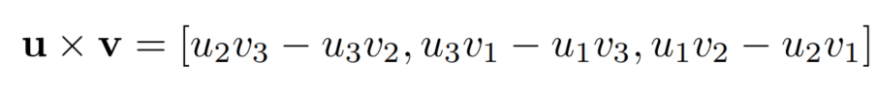
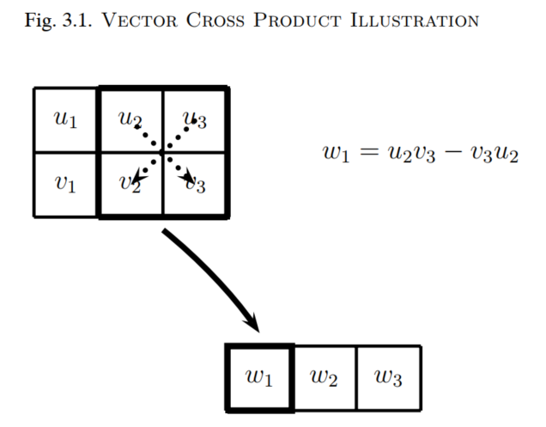
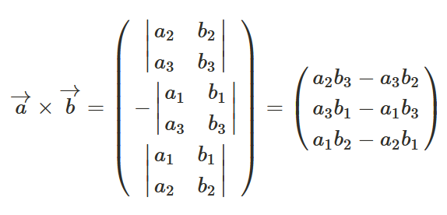
Correction: Cross product
Gill’s introduction
Using determinants

Slide 4
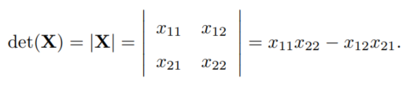
Determinant: 2x2

Slide 5

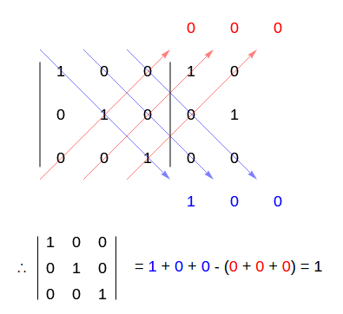
Determinant: 3x3
Trick for 3x3 using diagonals

Slide 6
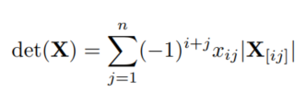
Determinant: nxn

Slide 7
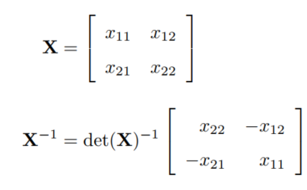

Inversion 2X2
Hint for exercises: Remember negative exponents are fractions

Slide 8

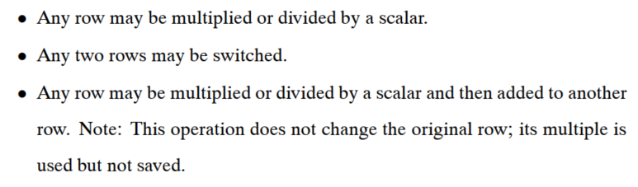
Inversion: gauss-Jordan elimination
Algorithm to solve the linear equation
Goal: zero out the off-diagonals of the left matrix and divide to obtain 1’s on the diagonal

Slide 9
Exercises
This week found as a github classroom assignment with this link:
https://classroom.github.com/a/tHkrE883

